Slide 1
Advanced Topics in Programming Lab 6 – Client-Server + Strategy
We will start at 9:10
Lab schedule:
Sockets
Server
Client
Strategy Design Pattern in Server and Client
Lab exercise 1
Lab exercise 2
Log4j2
Lab exercise 3

Slide 2
Advanced Topics in Programming
Lab 6 – Client-Server + Strategy

Slide 3
Sockets

Slide 4
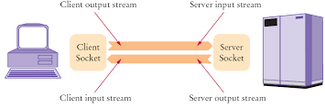
Sockets
A socket is an endpoint in the network
A socket is defined by:
IP address
Port number
The Server has an IP address and listens to a specific Port
The Client connects to the Server using the known IP and Port of the Server
They talk with each other and when finished, they end the connection

Slide 5
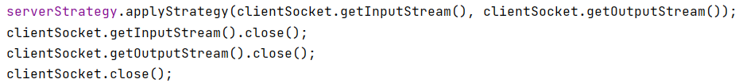
Server
The Server opens a new Socket and listens to it
It waits until a Client Socket connects to it
When it receives a new Client, it applies a Strategy to communicate with it, and when done – it closes the communication streams

Slide 6
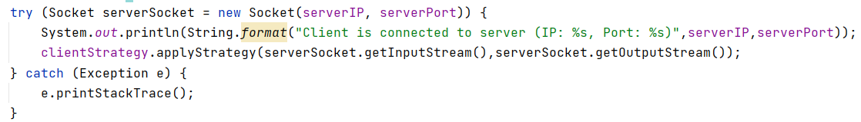
Client
The Client connects to the Server, and starts communicating using a Strategy

Slide 7
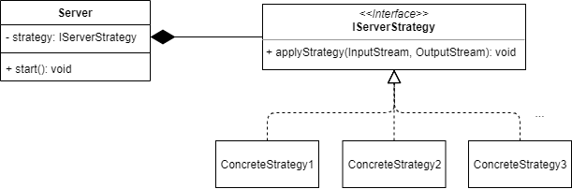
Strategy
Same for Client…

Slide 8
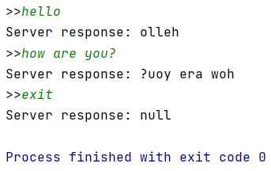
Lab exercise 1
Create a Client-Server application for reversing Strings.
The Client asks the user to enter Strings one at a time
For each String, the Client send the String to the Server, and waits for Server reply.
The Server gets a String, reverse it, and sends it back to the Client.

Slide 9
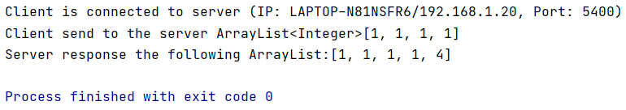
Lab exercise 2
Add another functionality to the previous Client-Server application:
The Client sends an ArrayList with some integers in it.
The Server receives the ArrayList, and adds another item to it.
The added item will be the size of the ArrayList.
Then the Server sends the ArrayList back to the Client and terminates the communication.

Slide 10
Log4j2

Slide 11
Log4j2
We want to log stuff in a file
Connections to the Server
Exceptions that were thrown
Debug notes
Etc…
We want to keep the data separated by the different log levels

Slide 12
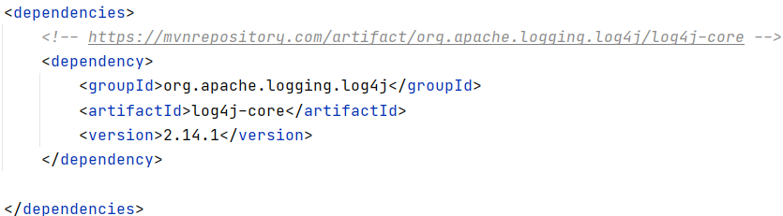
Log4j2 – import using Maven
Add framework support
Choose Maven
In the pom.xml file, add the dependency of:
It can be found here

Slide 13
Lab exercise 3
Add to the Client-Server code from earlier, logs of Server info, exceptions, etc…

